Slide 1


Audio & Lighting
By Henry Bryant

Slide 2

Recap
Colliders, Triggers, Scene Change, Animation, Buttons, Triggers
https://drive.google.com/drive/u/1/folders/1HT-8_gX1_RTrNCV9wBcgb9W5eepmgHk6

Slide 3

Timeline
Week 4 - Unity Collaboration
Week 5 - Virtual Reality Setup
Week 6 - Colliders, Triggers, Scene Changes, Animation, Buttons Triggers
Week 7 - Spring Break
Week 8 - Midterm Presentations
Week 9/10 - Lighting & Sounds
Week 11 - Optimization

Slide 4
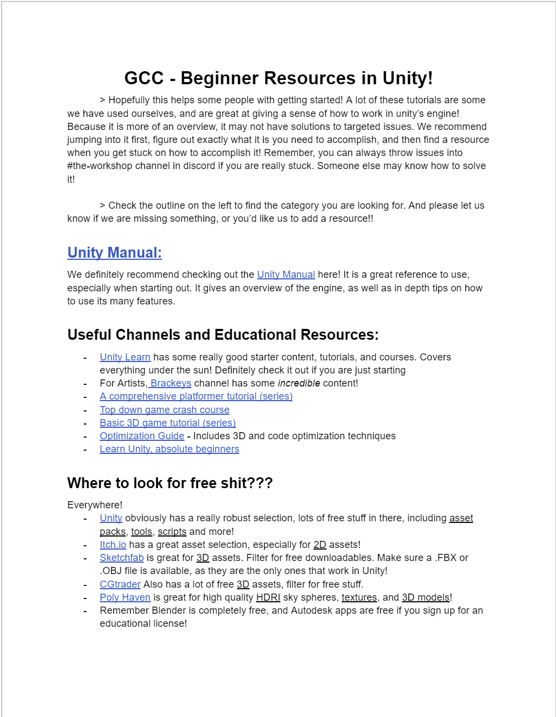
GCC Resources Doc
Game Creator Coalition at VCU’s Beginner Resources in Unity
Checkout the GCC Discord for Game Dev community at VCU

Slide 5
Alternate Lighting & Sound Guides
Sound
Unity Learn
Spatial Audio
Example Audio Project
Lighting
Light probes
Light up Your Game - YT Tutorial

Slide 6
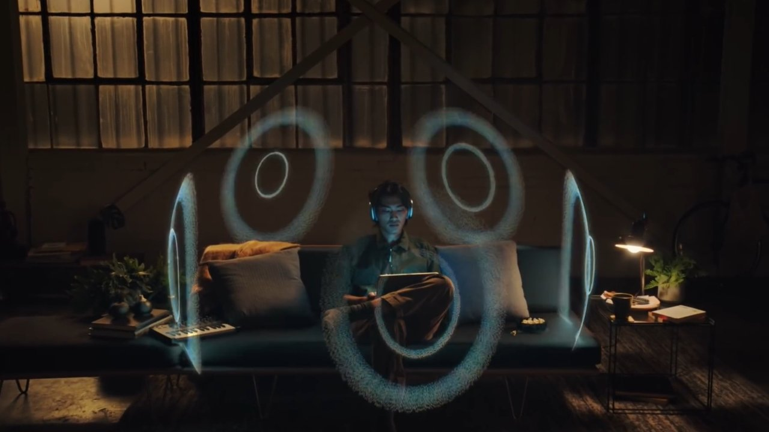
Sound - Things to Consider
Spatial Awareness
Feedback/Interactivity
Immersion/Storytelling
Realism

Slide 7
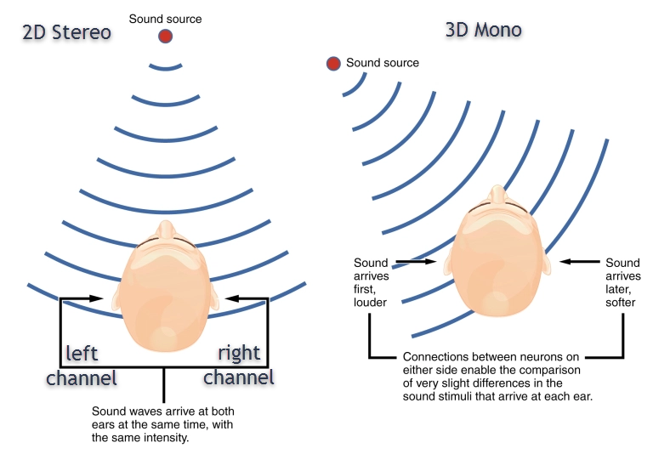
Types of Audio in Unity
Types of Audio in Unity:
Ambient
Background music, doesn’t take into account position (2D)
Spatial
Proximity sounds, only if the player is in a certain area (3D)
Eg: fire crackling
This can be used to play different levels in both ears depending on orientation
One-Shot
Audio files that just play once when triggered, can be 2D or 3D
Button click sound
Mixed
Combine all these methods to create immersive auditory experiences.

Slide 8
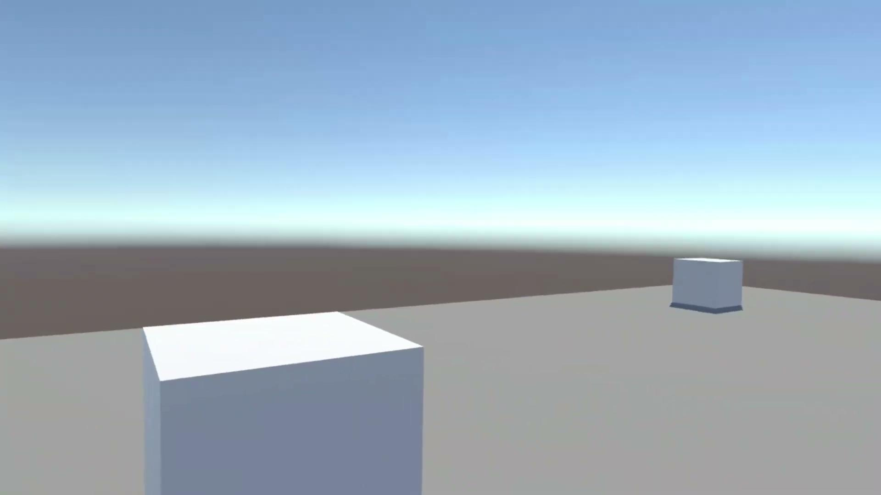
Sound Demo

Slide 9
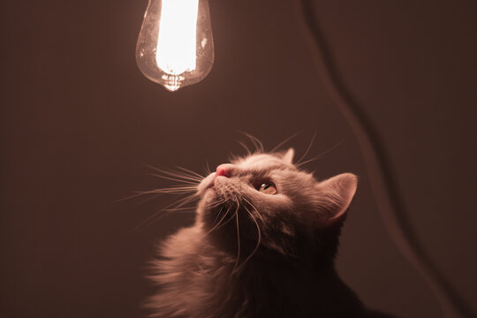
Lighting

Slide 10
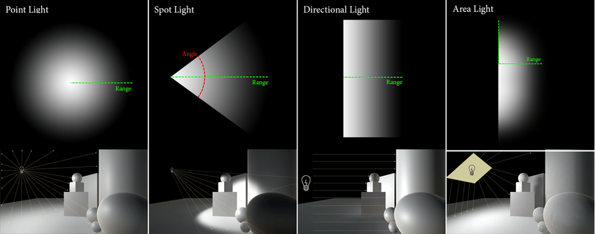
Light Sources
Directional Light
Point Light
Spot Light
Area Light

Slide 11
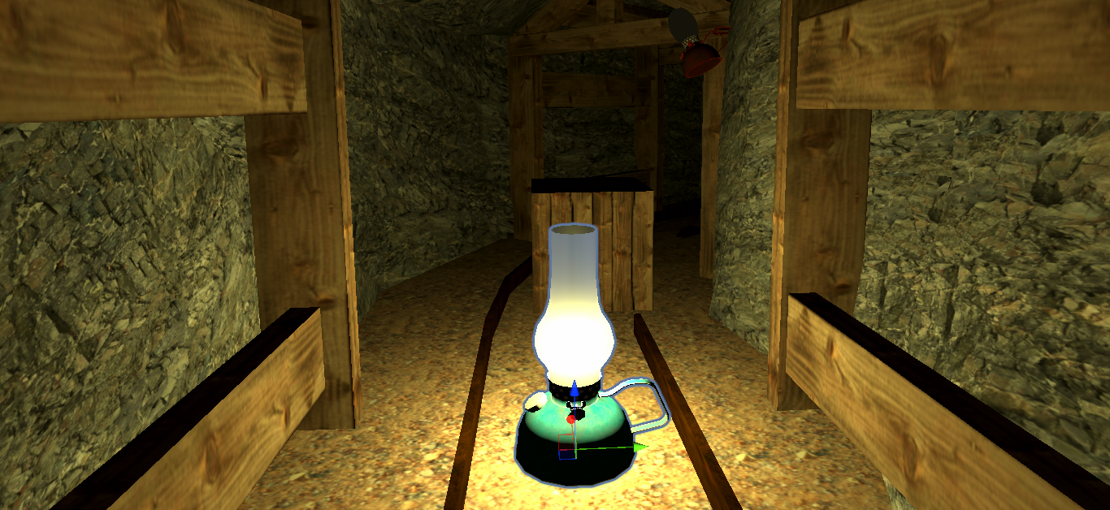
Lighting: Realtime
Pros
Dynamic
Shadows!
Cons
Performance heavy
Example
Flashlight
Day-cycle

Slide 12
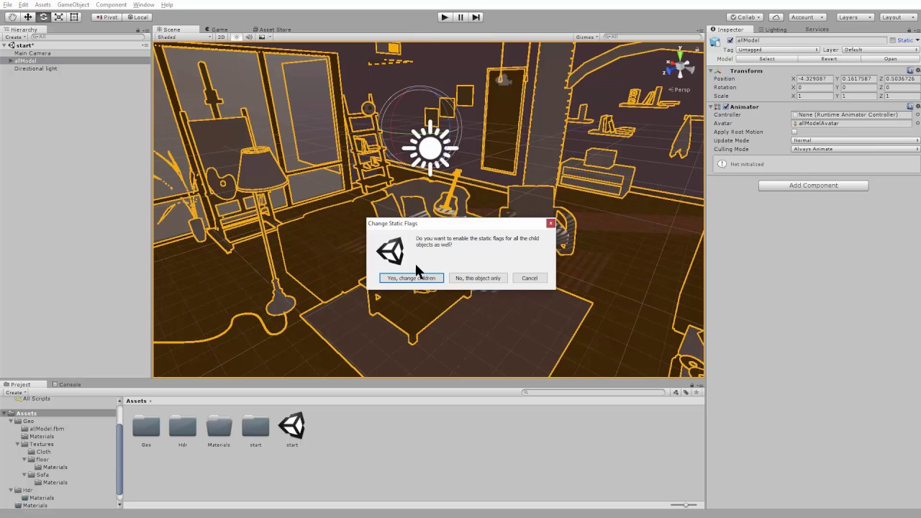
Lighting: Static/Baked
Pros
Optimal for Performance
Cons
Objects have to be static
Precomputes lighting information

Slide 13
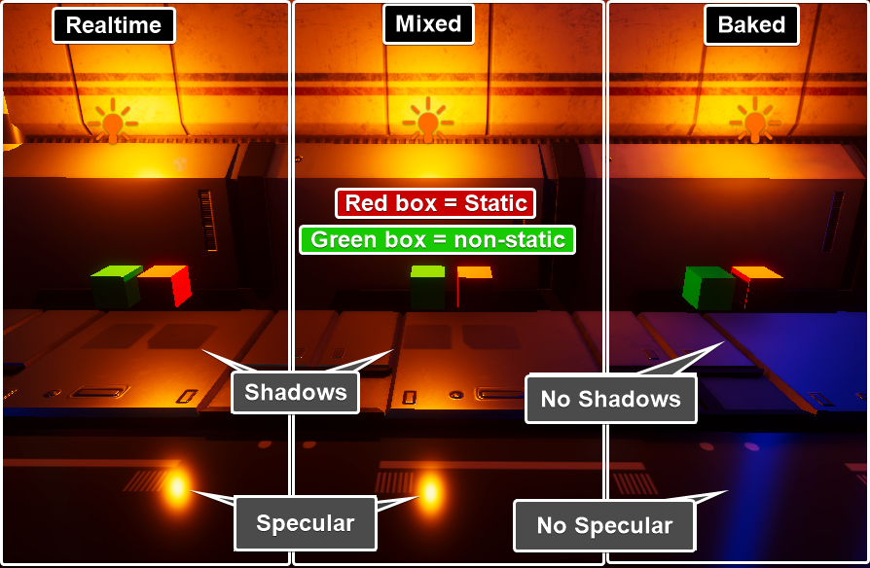
Lighting: Mixed
Pros
Bakes some things while allowing for some realtime lighting!
Cons
Sometimes can leave artifacts

Slide 14
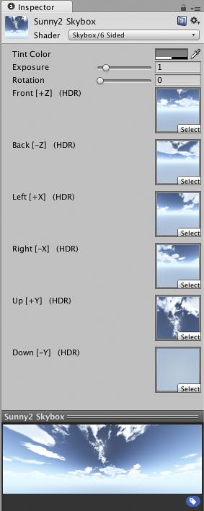
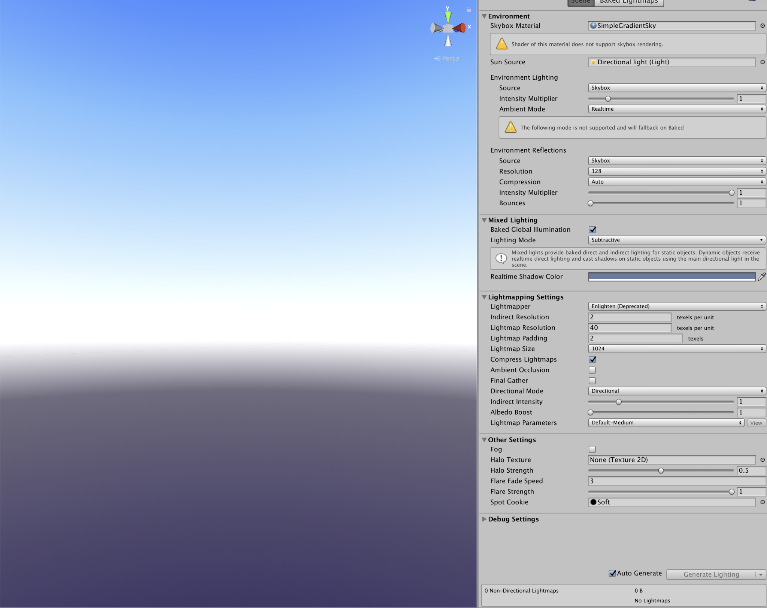
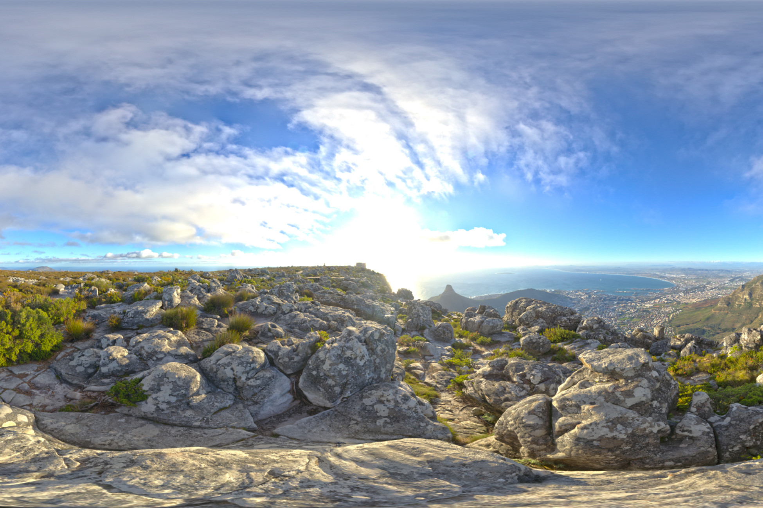

Skyboxes
Procedural
HDR
6 sided
panoramic

Slide 15
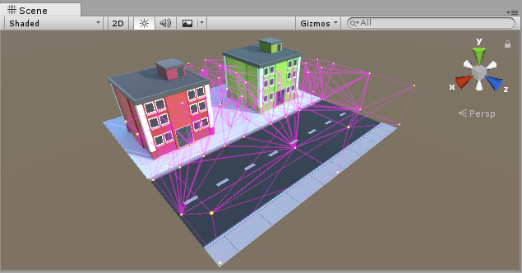
Light Probes
These are particularly important for lighting scenes that contain both static and dynamic objects.

Slide 16
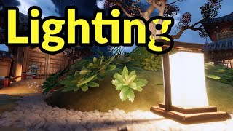
Lighting Demo

Slide 17

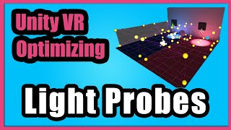
Extra Lighting Tutorials

